Slide 1
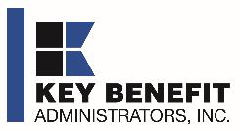
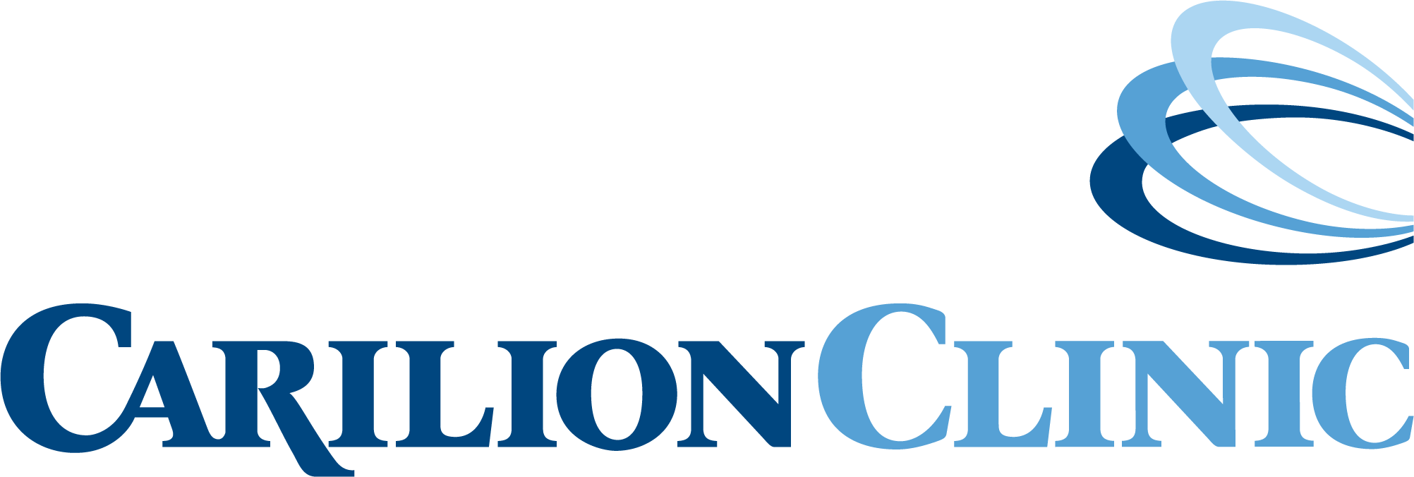
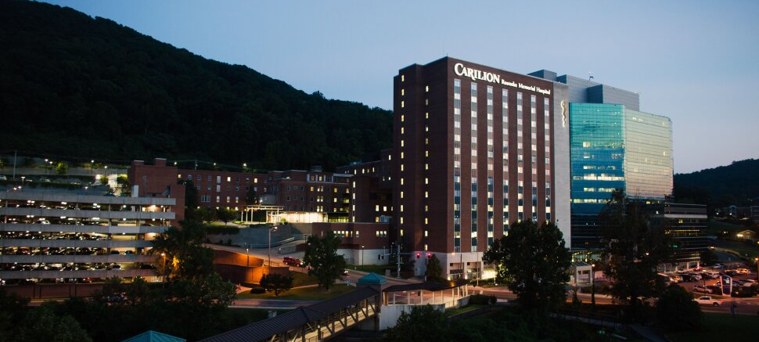
DIRECT-TO-EMPLOYER PLAN
August 9, 2024

Slide 2


Healthcare Leader in Private Labeled DTE Plans
Louisville, KY
OneHealth Plan
Cincinnati, OH
TCH Optimal
Bentonville, AR
Northwest Health Plan
Knoxville, TN
East Tennessee Health Plan
Meridian, MS
Affinity Health Plan
Fort Myers, FL
Lee Health Care Partners

Slide 3


Direct-to-Employer (DTE) Your health plan focused on a direct relationship with self-funded employers in Your market
YOU Pick the Name of the Health Plan
YOU Determine the Fees Charged
YOU Practice the Medicine
YOU Receive the Profits
WE Make it Successful

Slide 4
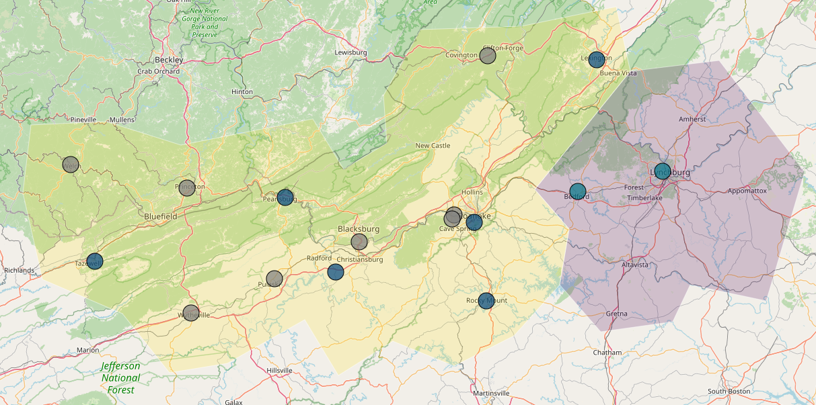

Significant Opportunity for Plan Growth Researched for Roanoke and Lynchburg Hospital Referral Regions*
Target Market 900+ Employers 120,000+ Employees 190,000+ Members
 | Employer Size Group (# of Employees)
Commercial Employers Headquartered in: | 50-100 | 101-200 | 201-400 | 401-1,000 | 1,001-3,000 | 3,000+
Lynchburg Hospital Referral Region | 137 | 54 | 32 | 20 | 3 | 3
Roanoke Hospital Referral Region | 350 | 146 | 107 | 60 | 24 | 6
Estimated Employees in: | 50-100 | 101-200 | 201-400 | 401-1,000 | 1,001-3,000 | 3,000+
Lynchburg Hospital Referral Region | 10,275 | 8,100 | 9,600 | 14,000 | 6,000 | 14,300
Roanoke Hospital Referral Region | 26,250 | 21,900 | 32,100 | 42,000 | 48,000 | 55,100
Estimated Members in: | 50-100 | 101-200 | 201-400 | 401-1,000 | 1,001-3,000 | 3,000+
Lynchburg Hospital Referral Region | 16,440 | 12,960 | 15,360 | 22,400 | 9,600 | 22,880
Roanoke Hospital Referral Region | 42,000 | 35,040 | 51,360 | 67,200 | 76,800 | 88,160
*Hospital Referral Regions (HRRs) are geographic regions in the U.S. that define healthcare markets based on patient referral patterns for major cardiovascular and neurosurgery procedures, created by the Dartmouth Atlas of Health Care.
Centra Southside Community Hospital is not included as it is a smaller hospital in a separate Hospital Referral Region and its isolated location will not contribute to DTE growth in that region.

Slide 5
Direct-to-Employer Strategy: Only Available to Premier Health Systems
STRONG Brand Quality
EXTENSIVE Patient Access
AFFORDABLE Value Pricing
EXCELLENT Care Quality

Slide 6
Critical for Success: Strong Brand and Care Quality
Hospital Name | Total Beds | HCAHPS Recommendation Percentile | CMS Stars Percentile | Mortality Percentile | Readmission Percentile | Key Benefits Brand Quality Estimate
Carilion Franklin Memorial Hospital | 37 | 75 | 60 | 63 | 85 | 71
Carilion Giles Community Hospital | 25 | 75 | 87 | NA | 61 | 71
Welch Community Hospital | 49 | 78 | NA | 56 | 39 | 70
Centra Bedford Memorial Hospital | 34 | 68 | 87 | 62 | 69 | 69
Lewisgale Hospital Montgomery | 92 | 72 | 60 | 83 | 49 | 69
Carilion Tazewell Community Hospital | 56 | 65 | NA | 53 | 49 | 68
Carilion Roanoke Medical Center | 636 | 65 | 60 | 69 | 96 | 67
Lewisgale Hospital Pulaski | 45 | 54 | 60 | 64 | 64 | 66
Carilion New River Valley Medical Center | 110 | 58 | 87 | 81 | 65 | 65
Carilion Rockbridge Community Hospital | 25 | 46 | 31 | NA | 65 | 61
Centra Lynchburg General Hospital | 443 | 33 | 60 | 60 | 82 | 56
Wythe County Community Hospital | 92 | 21 | 60 | 63 | 85 | 51
Lewisgale Hospital Alleghany | 95 | 21 | 87 | 66 | 86 | 50
Lewisgale Medical Center | 330 | 12 | 60 | 83 | 54 | 48
Princeton Community Hospital | 88 | 14 | 10 | 63 | 63 | 48

Slide 7
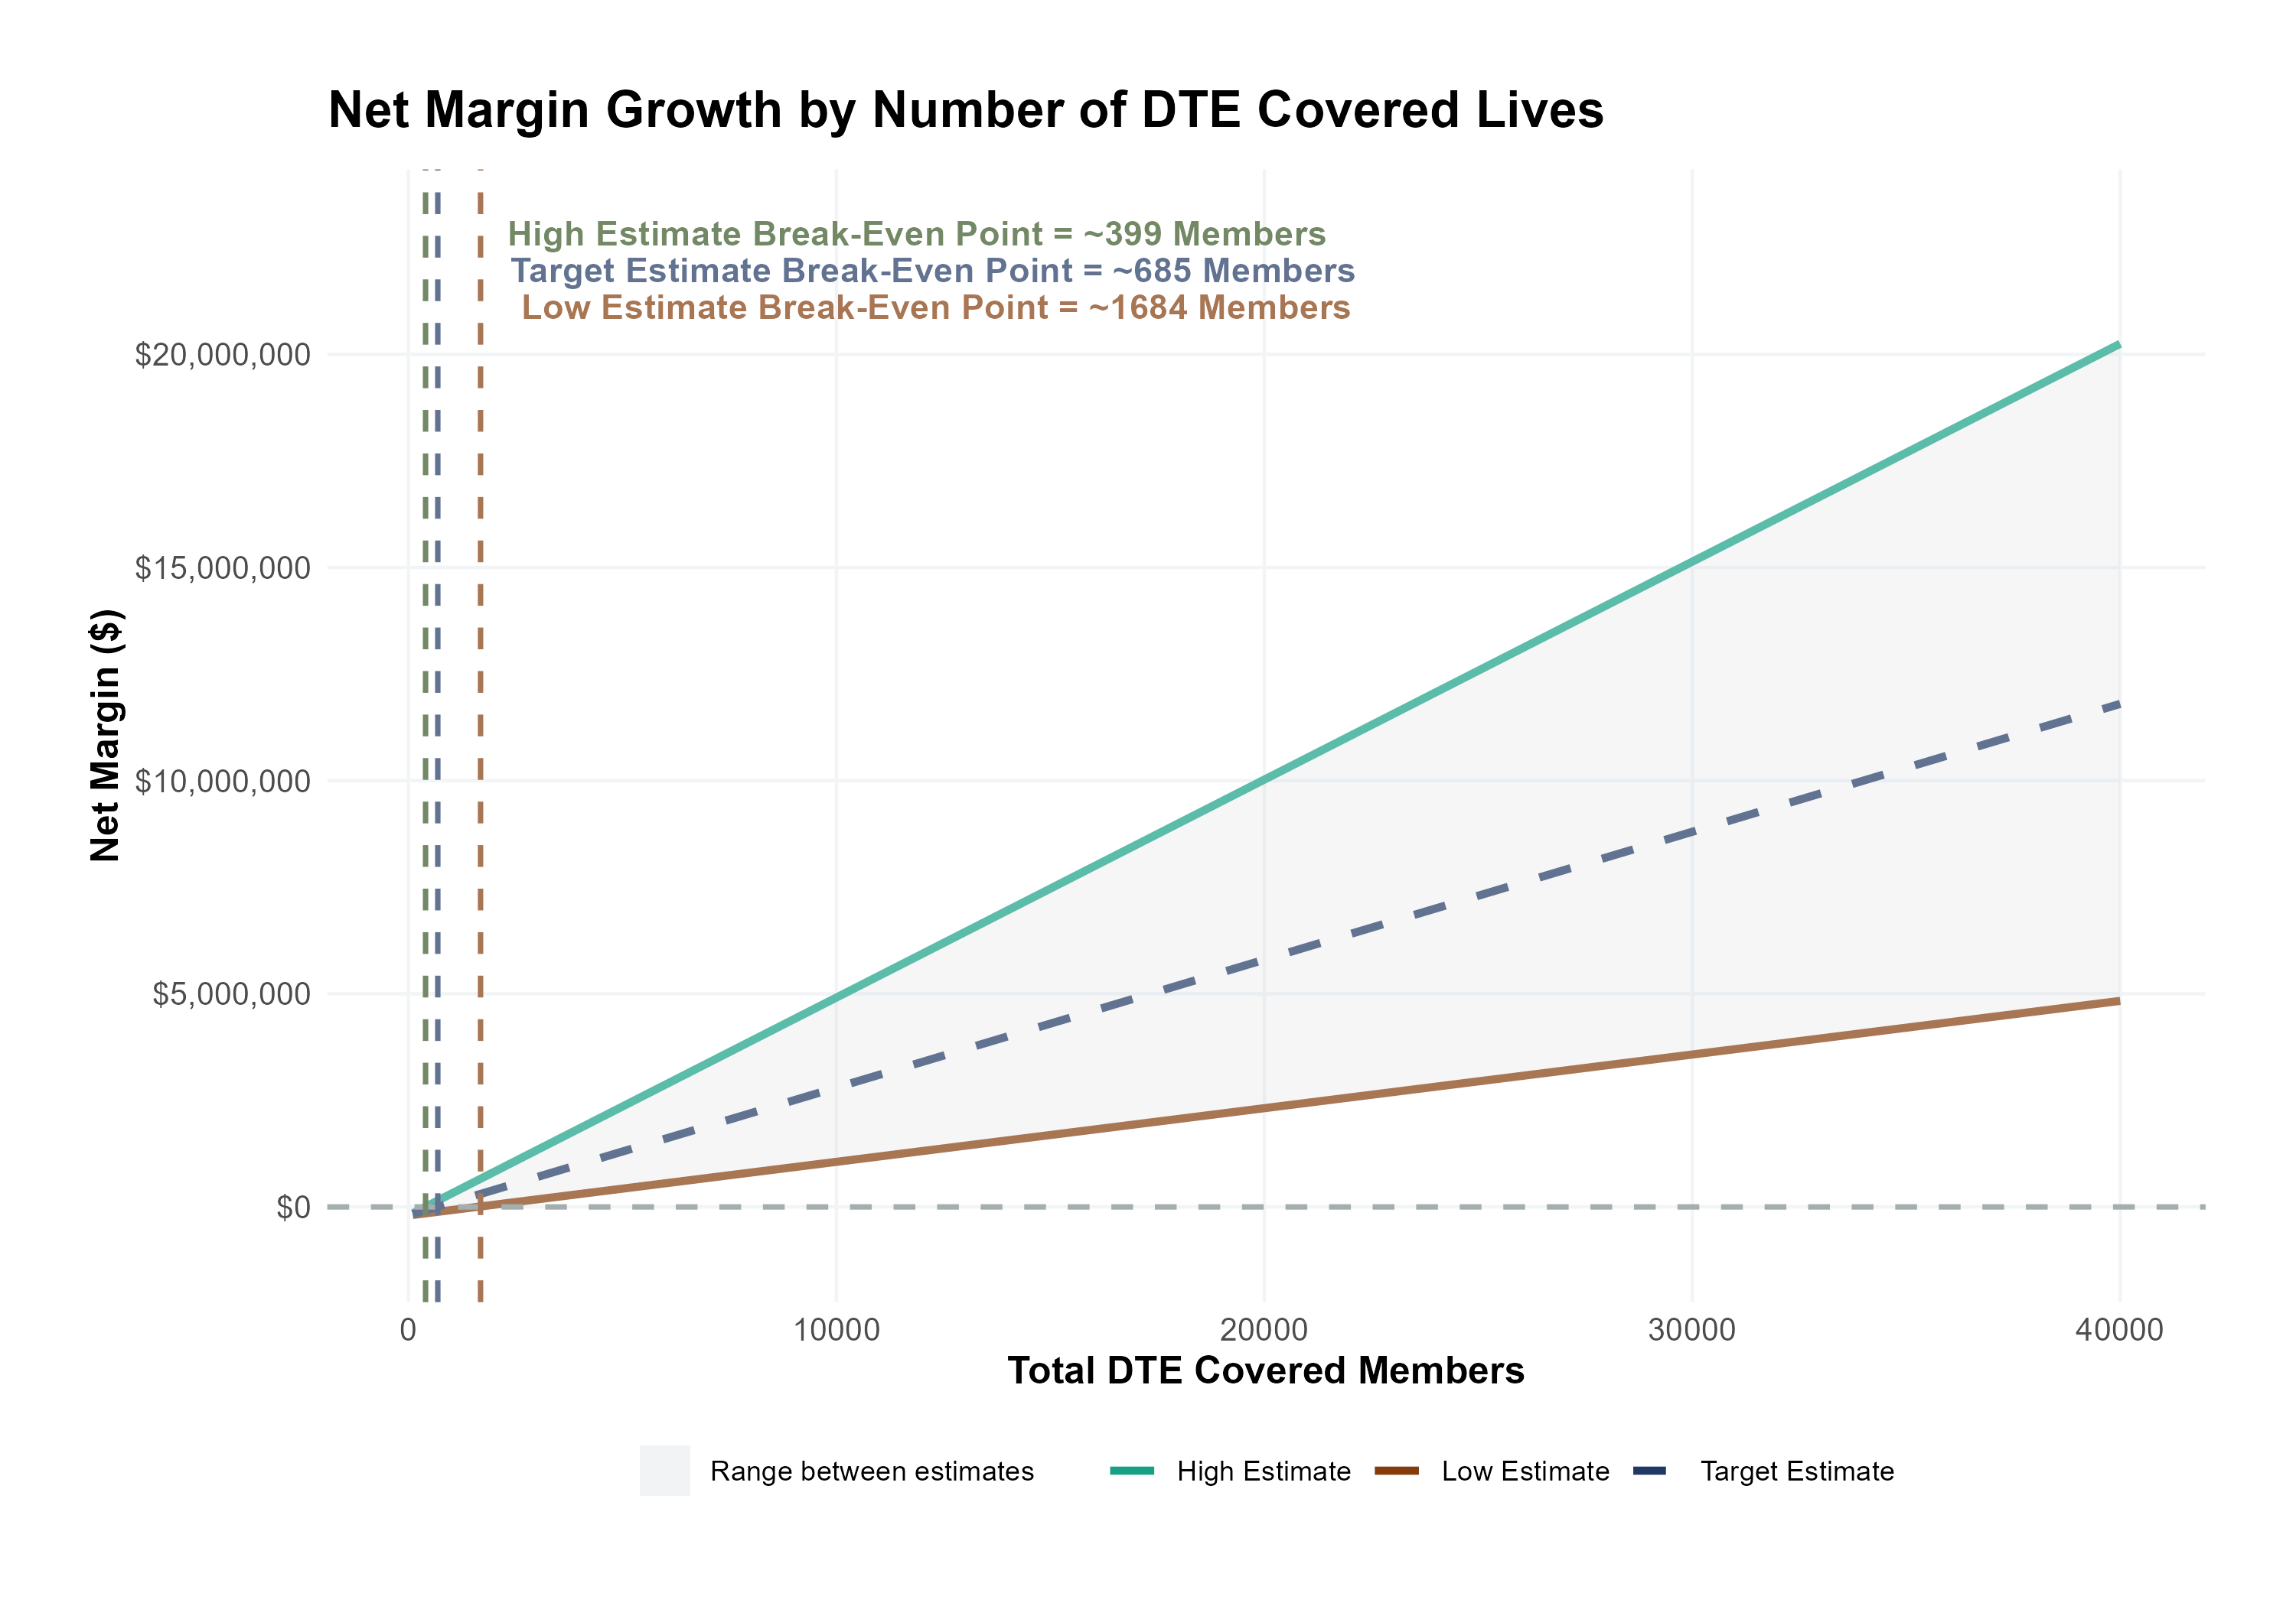
Estimated Financial Returns and Assumptions
Patient Steerage Assumptions
KBA currently estimates that Carilion Clinic has 46% inpatient market share, and 18% outpatient market compared to hospitals/clinics in the Lynchburg and Roanoke hospital referral regions. Based on other DTE networks and Centra Health being Tier 1, we expect steerage to be (inpatient/outpatient):
SINGLE-YEAR PROJECTION
Low
Target
High
53%/49%
57%/52%
60%/55%
Commercial Margin Assumptions
KBA observes a Carilion 44% commercial margin. Conservatively, we model the DTE to be 5% below commercial (10 percentage-point price reduction with a 5 percentage-point price increase from easier billing):
Low
Target
High
25%
33%
39%

Slide 8
SINGLE YEAR SUMMARY
DTE Covered Members Financial Analysis | DTE Covered Members Financial Analysis | DTE Covered Members Financial Analysis | DTE Covered Members Financial Analysis | DTE Covered Members Financial Analysis | DTE Covered Members Financial Analysis | DTE Covered Members Financial Analysis | DTE Covered Members Financial Analysis
Expected Estimate of 58.5% Inpatient/52% Outpatient Within-Plan Steerage and a Commercial Margin of 33%. | Expected Estimate of 58.5% Inpatient/52% Outpatient Within-Plan Steerage and a Commercial Margin of 33%. | Expected Estimate of 58.5% Inpatient/52% Outpatient Within-Plan Steerage and a Commercial Margin of 33%. | Expected Estimate of 58.5% Inpatient/52% Outpatient Within-Plan Steerage and a Commercial Margin of 33%. | Expected Estimate of 58.5% Inpatient/52% Outpatient Within-Plan Steerage and a Commercial Margin of 33%. | Expected Estimate of 58.5% Inpatient/52% Outpatient Within-Plan Steerage and a Commercial Margin of 33%. | Expected Estimate of 58.5% Inpatient/52% Outpatient Within-Plan Steerage and a Commercial Margin of 33%. | Expected Estimate of 58.5% Inpatient/52% Outpatient Within-Plan Steerage and a Commercial Margin of 33%.
DTE Members | Pre-DTE Revenue | Pre-DTE Margin | DTE Revenue | DTE Incr. Revenue | DTE Total Margin | DTE Incr. Margin | Net Margin Less DTE Fees
100 | $ 429K | $ 160K | $ 583K | $ 155K | $ 189K | $ 29K | $ -171K
500 | $ 2,144K | $ 800K | $ 2,917K | $ 773K | $ 943K | $ 146K | $ -51K
1,000 | $ 4,288K | $ 1,600K | $ 5,835K | $ 1,547K | $ 1,885K | $ 293K | $ 99K
2,500 | $10,720K | $ 4,000K | $ 14,587K | $ 3,867K | $ 4,714K | $ 732K | $ 549K
10,000 | $42,881K | $16,000K | $ 58,349K | $15,468K | $18,854K | $2,927K | $2,799K
20,000 | $85,762K | $32,001K | $116,697K | $30,935K | $37,709K | $5,855K | $5,800K
NOTE: Please see detailed financial analysis and assumptions used starting on page 23.
Financial projections do not include 340B contribution margin, which could represent $136 PMPM by optimizing 340B through Rx plan design, Carilion’s approved site(s) with network integration, and development of Carilion’s proprietary PBM program.

Slide 9



Founded in 1979 and headquartered in Indianapolis, IN​
Full-service TPA specializing in the administration of self-funded health plans and population health management​
One of the country’s largest independently-owned TPAs
The Key Family is a commonly-held group of benefits related organizations with:​
3,000+ corporate clients​
3.0 million members under management​
700 Employees
Exclusive Relationships
We know The Market – Agents, Networks, and MGAs

Slide 10

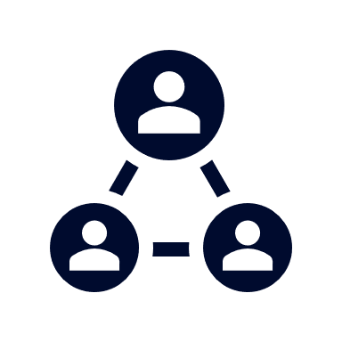



A Partner You Can Trust
OUR OBJECTIVES ARE ALIGNED
WE KNOW THE
MARKET
COMPLETELY TRANSPARENT
WE HAVE THE SOPHISTICATION AND INFRASTRUCTURE TO EFFECTIVELY COMPETE
Derek Moore, Senior Vice President – KBA
845-283-9973 * derek.moore@keybenefit.com

